Slide 1

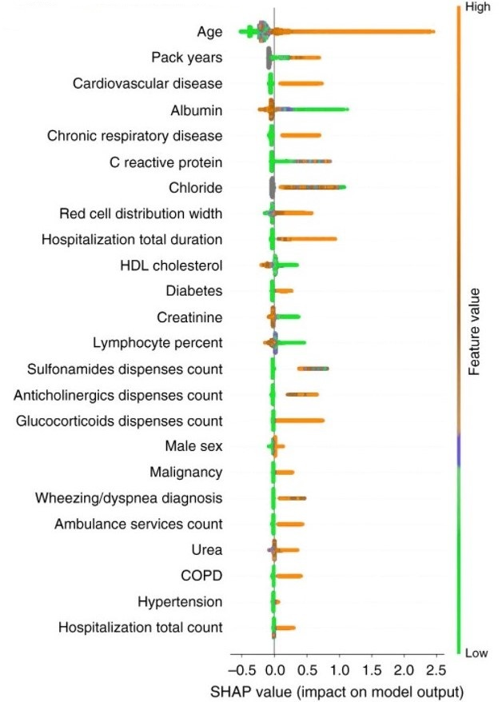
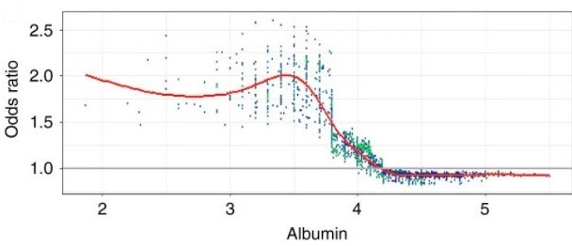
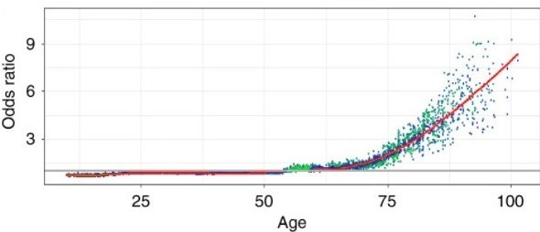
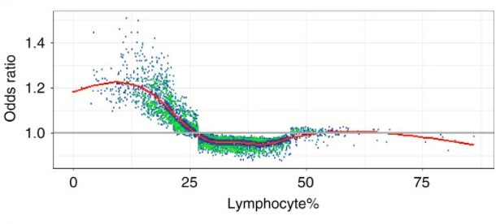
Building up a COVID-19 hazard prediction model
Author XX, Author YY
Organization of the author (E.g. National Institute of Technology Delhi)
Abstract
The abrupt expansion in COVID-19 cases is squeezing medical care administrations around the world. For this reason, AI devices chose three biomarkers that foresee the mortality of individual patients over 10 days ahead of time with over 90% exactness: lactic dehydrogenase, lymphocyte and high-affectability C-responsive protein. This finding is steady with ebb and flow clinical information that high LDH levels are related with tissue breakdown happening in different infections, counting aspiratory issues like pneumonia.This indicator is approved to have great segregation and alignment. To help dynamic and strategic arranging in medical services frameworks, this examination use a data set of blood tests from 485 tainted patients in the locale of Wuhan, China, to distinguish vital prescient biomarkers of infection mortality. [1]
Fig. 1: Summary and feature-specific SHAP values for the baseline model [2]
a. A summary plot of the SHAP values for each feature.
b. A plot of the odds ratio for different values of age.
c. A plot of the odds ratio for different values of percent of lymphocytes in the blood.
d. A plot of the odds ratio for different values of albumin.
Introduction
COVID-19 has been causing overall wellbeing worries since December 2019. The infection causes fever, hack, weariness and gentle to serious respiratory inconveniences, which, if exceptionally extreme, can prompt patient demise. On March 2020, the infection flare-up was pronounced a pandemic by the World Health Organization. Up until this point, it has been accounted for that 13.8–19.1%of COVID-19-tainted patients in Wuhan, China, turned out to be seriously ill. This issue was planned as an order task, where the data sources included essential data, manifestations, blood tests and the consequences of research facility tests, including liver capacity, kidney work, coagulation capacity, electrolytes and incendiary variables, taken from initially broad, serious and basic patients , just as their related results comparing to one or the other endurance or demise toward the finish of the assessment time frame. [1]
Method and Materials
The source of data was set up by the help of CHS data warehouse based in Israel, which contains both medical data and claims data. CHS allows long follow-up of patients in the data warehouse. After that the baseline model was set up by prohibiting the patients younger than 10 years which was done dependent on the extremely low paces of COVID-19 mortality. (was recognized by the pattern model made inclination in the last COVID-19 model). Change of the expectations from the pattern model was finished utilizing a multicalibration algorithm. The adjusted outcomes were then tested. This examination was affirmed by CHS' institutional survey board. [2] Information were gathered utilizing SQL Server 2017. The pattern model advancement was finished utilizing Python variant 3.6, Anaconda rendition 5.1.0, and LightGBM form 2.2.3. The model presentation investigation and plot creation were done in R form 3.5.2. [1]
Conclusions
In outline, this investigation has recognized three pointers (LDH, hs-CRP and lymphocytes), along with a clinical course for coronavirus prognostic expectation. A XGBoost AI based model has been built that can anticipate the death rates of patients over 10 days ahead of time with over 90% precision conceivably a decrease of mortality in patients with COVID-19. [1]
Future Prospects
Hazard separation can additionally be utilized for prioritization of COVID-19 RT-PCR tests, alongside different models like manifestations and possible openness. The model will be used to settle on the spot of treatment of affirmed cases.With the assistance of this patients at the high-hazard can be treated outside a medical clinic. It is expected that this result will give a decent positioning of the populace concerning the danger for a serious course of illness. This methodology is considered to give a proficient mix of individual-level information and epidemiologic reports. The COVID-19 indicator portrayed can be possibly utilized straightforwardly. [1] [2]
Project Objectives
This project proposes a straightforward and operable choice standard to rapidly foresee patients at the most noteworthy danger, permitting them to be focused on and possibly lessening the death rate. [2]
To propose a guideline to rapidly anticipate patients at the most noteworthy danger. [2]
Results Baseline Model - Fig.1 Figure 1a presents the general significance and impact of all factors in the model.The figure additionally shows the prescient commitment of missingness — whereby a missing worth in a component is a sign in regards to the patient's danger. Figure 1b presents the odds ratios across different values of three selected variables1. Similar figures for the rest of the variables are included in Supplementary Fig. 1. [2]
Reference
[1] L. Yan et al., “An interpretable mortality prediction model for COVID-19 patients,” Nat. Mach. Intell., vol. 2, no. 5, pp. 283–288, 2020.
[2] N. Barda et al., “Developing a COVID-19 mortality risk prediction model when individual-level data are not available,” Nat. Commun., vol. 11, no. 1, pp. 1–9, 2020.
Department Name of the Author
Organization Name of the Author

